Slide 1

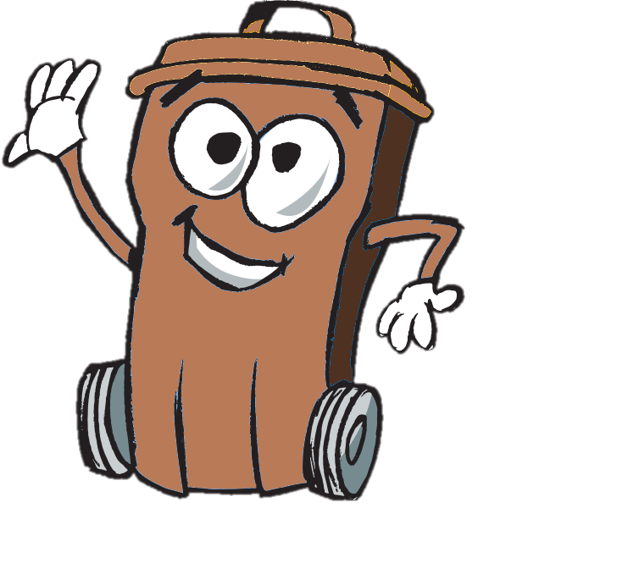


Food Waste
This is Compo – Wheelie’s food bin friend. He would like to tell you all about food waste.
Notes:
Welcome to the Wheelie Big Challenge from Eco-Schools supported by Antrim and Newtownabbey Borough Council. This is Compo – Wheelie’s brown food bin friend. He would like to tell you all about food waste.

Slide 2
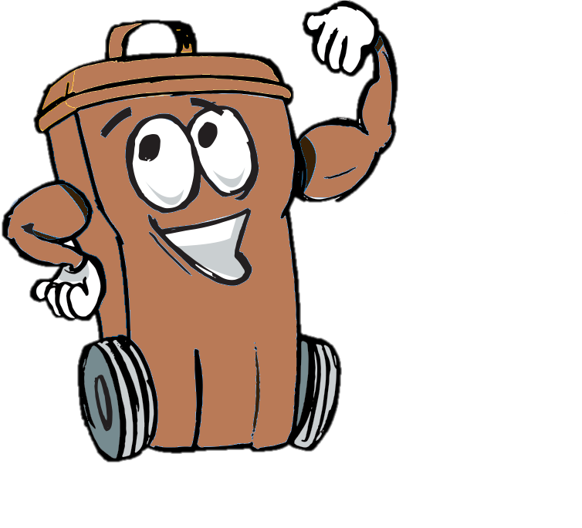
Wheelie’s Lessons
learn and think
Wheelie Big Actions
research and act
Wheelie Big Competition
report, display and win!
Notes:
The Wheelie Big Challenge is in 3 parts. In 2019 we are asking schools to look at food waste as well as other recycling.

Slide 3
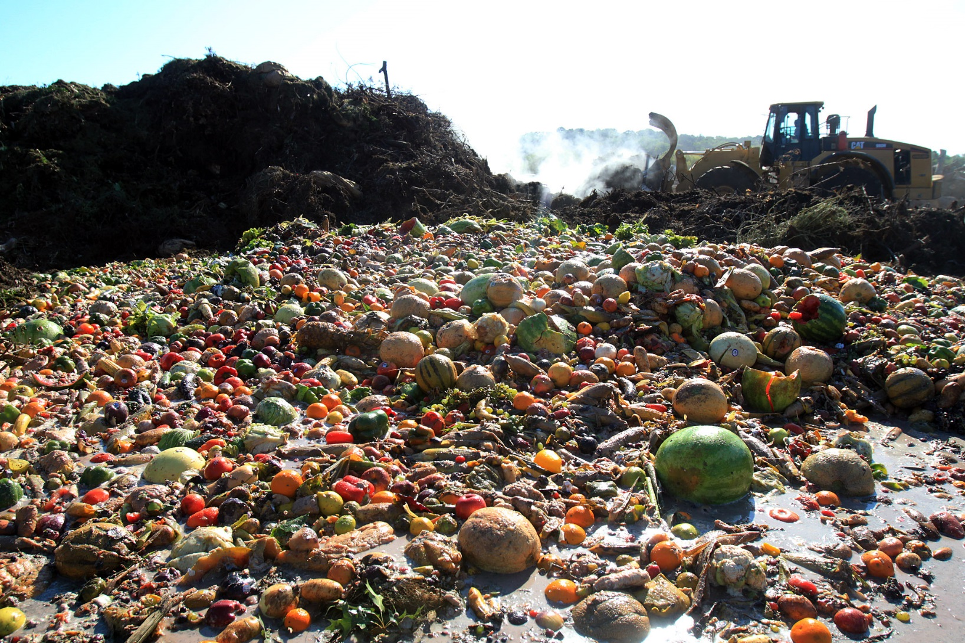
How much food do we waste?
Almost ½ of the world’s food production never reaches a plate
Notes:
What is waste? – for this challenge we are talking about our rubbish that goes to landfill and is not recycled. We throw away a shocking amount of food each year.

Slide 4
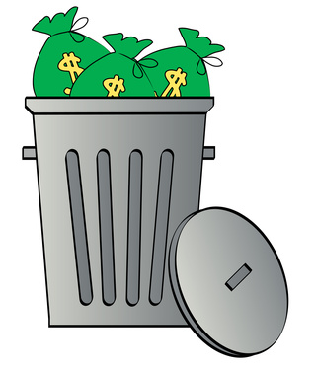

That’s a lot of waste!!
Why should we care?
Because it costs money
and it’s bad for the environment.
Notes:
Disposing of waste costs the tax payer and your council a lot of money. That money could be spent on better things like parks and leisure facilities. Landfill sites are also very bad for the environment, as well as being unsightly, they cause litter and air pollution, harm wildlife and contribute to global warming.

Slide 5
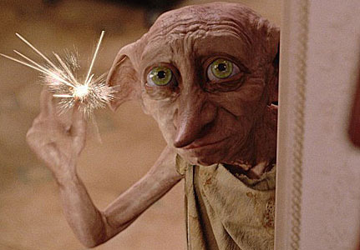
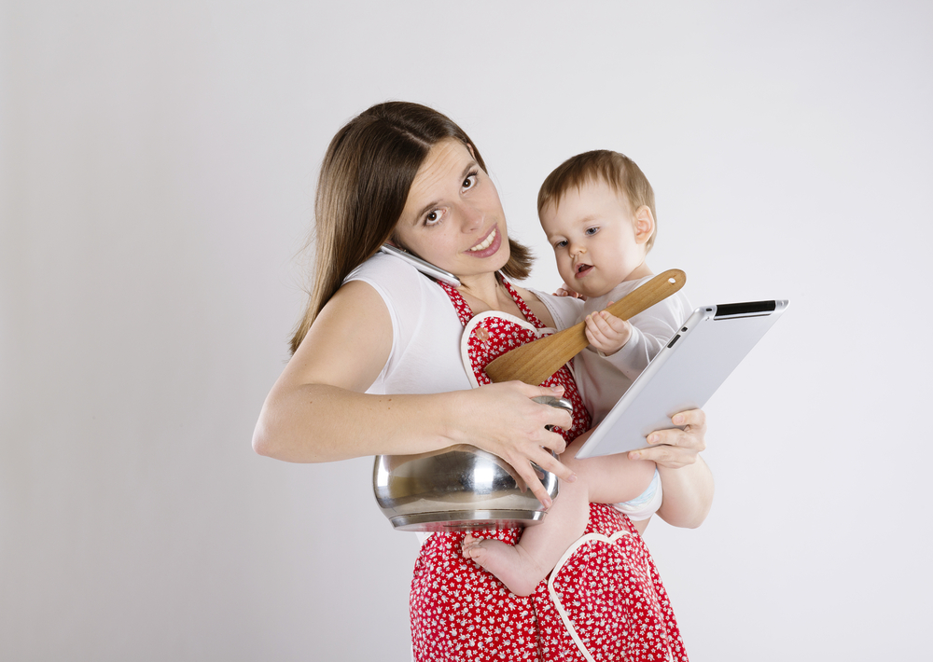
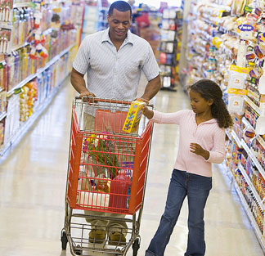
Where does your food come from?
It doesn’t appear by magic
It takes a lot of energy to make it – and not just from your Mum!
If you said ‘supermarket’ that’s only part of the story.
Notes:
Ask pupils where they think their food comes from. You could visit your local shop and look for the product which has travelled the furthest.

Slide 6
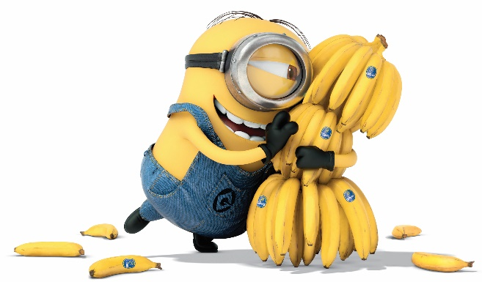
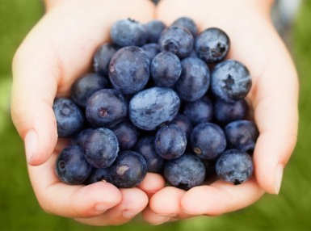
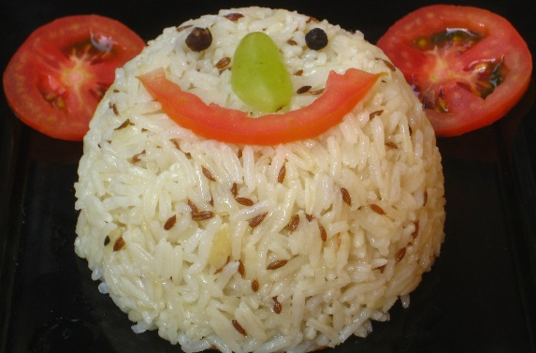
A lot of your food will probably have travelled a long way before it arrives on your plate
Bananas travel almost 5000 miles to the UK!
That’s from Belfast to Dublin and back 25 times!
Blueberries travel 3500 miles to the UK.
That’s Belfast to London 25 times!
Rice has to travel a massive 7000 miles to reach us!
That’s the same as going from Belfast to Paris 14 times!

Slide 7
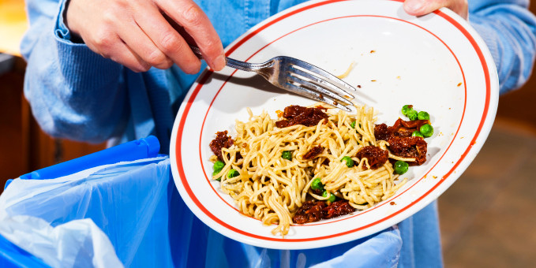
If you throw that food in the bin you are:
Wasting all the energy that got that food from farm to fork
Wasting money
Adding to the mountain of wasted food in landfill
Adding to climate change
Notes:
It is not just the food that is wasted when it goes in the bin but also all the energy, transport and storage costs and environmental impact at each stage of the journey that is wasted.

Slide 8
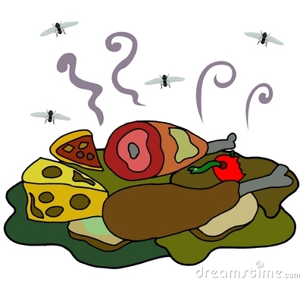
Food waste stinks!
That pongy smell is bacteria creating methane gas a potent contributor to climate change
Notes:
Methane is more dangerous and more damaging than CO2. Wasted food globally causes greenhouse gases equivalent to a large industrialised country and comes only third to the USA and China in terms of greenhouse gases emitted. The food we throw away is causing a greater environmental hazard than the packaging it comes in – yet most people, 88%, think packaging is a bigger or equal problem.

Slide 9
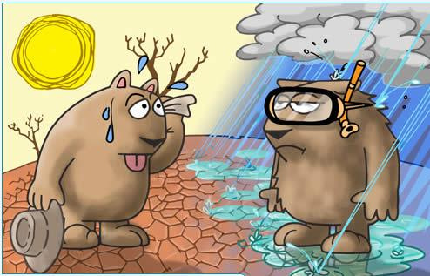
Greenhouse gases from industry and waste in our atmosphere trap the heat from the sun
Our planet is heating up a little every year
Global warming is affecting our climate and as a result we are experiencing more extreme weather events.
Notes:
Climate change does not necessarily mean warmer weather. Some countries where it is already warm will experience more droughts and here in Northern Ireland we are likely to experience wetter weather.

Slide 10
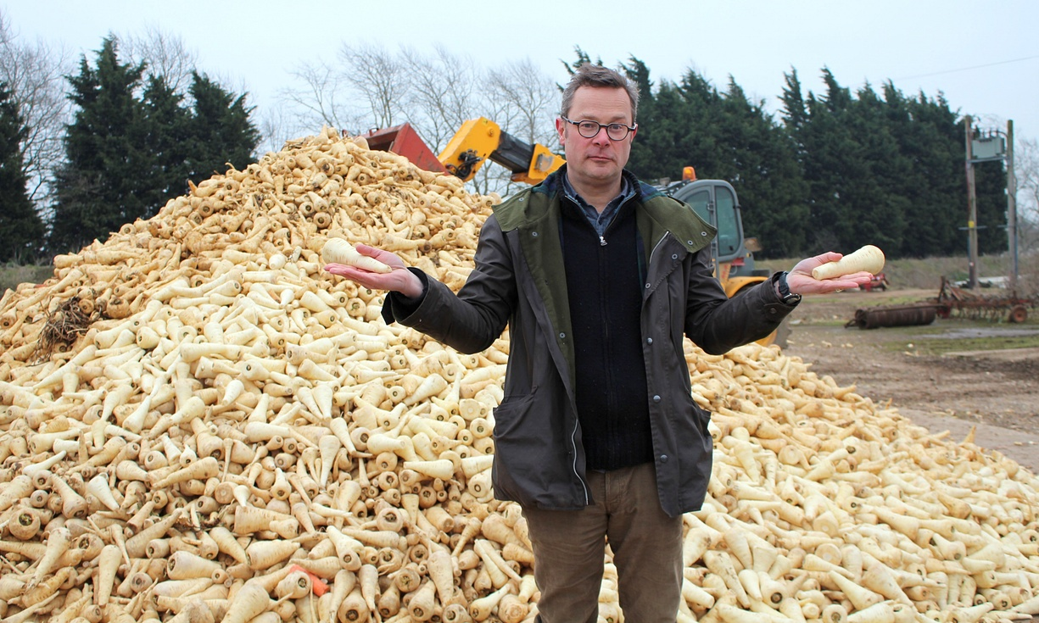
The wonky vegetable scandal
TV chef Hugh Fearnley-Whittingstall reported in a BBC programme ‘Hugh’s War on Waste’, that up to 40% of a farmers crop can be thrown away because it’s not quite the right shape or size to meet supermarket standards.
One farmer had to throw away 20 tonnes of vegetables a week!
It’s a bit crazy!
Notes:
Visit www.wastenotuk.com for more information on this anti-waste campaign and hints and tips.

Slide 11
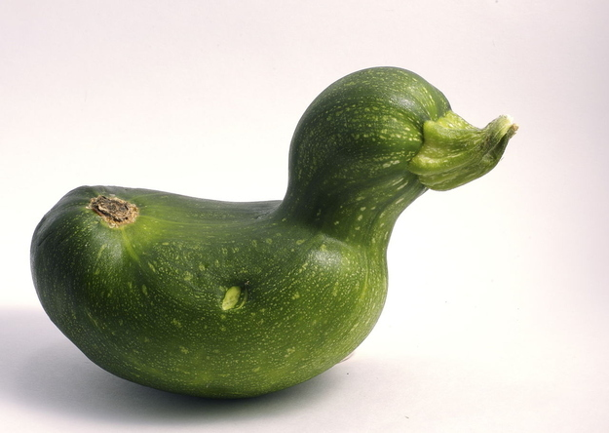
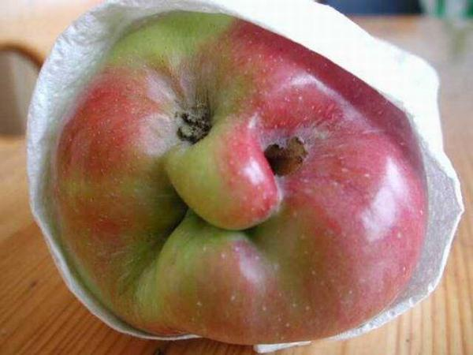
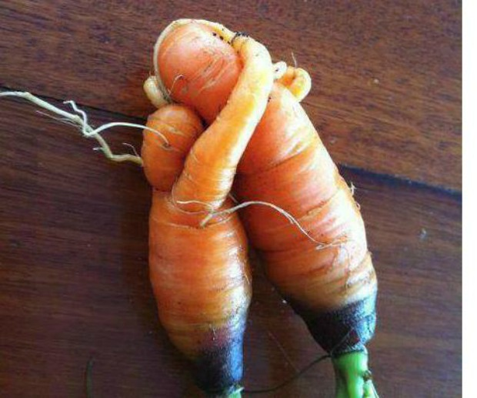
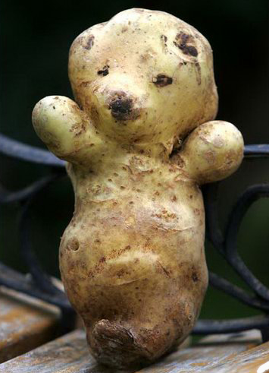
Even ugly veg need love !
And taste great!
Notes:
Food still tastes great no matter what the shape. Supermarket standards of appearance are not natural and creating a lot of wasted food.

Slide 12


Supermarkets aren’t the only ones wasting food.
£700 per family
£12.5 million
7 million tonnes
HOME
Notes:
Figures from Love Food Hate Waste based on the UK. 7 million tonnes of food costing the consumer £12.5 million is thrown away from UK households every year costing the a family household an average £700 a year. Visit www.ni.lovefoodhatewaste.com for more facts and figures.

Slide 13

What can we do?
Which is best?
Notes:
The 3 R’s are important if we are to become a sustainable society – but which is best?

Slide 14

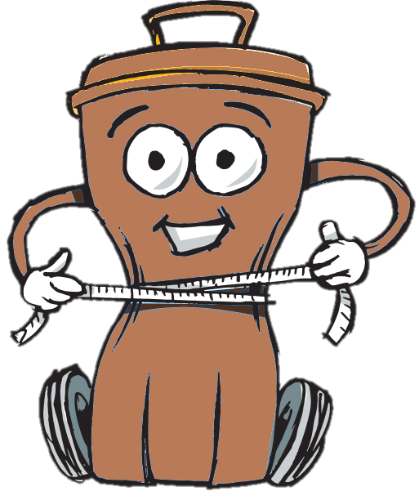
is the best option
Reduce waste
  buy only what you need
  manage portion sizes
  check sell by dates
  use a shopping list
  store food properly
Save the environment
Save money
Notes:
Reduce is always the best option because it will use less natural resources and less energy in the first place. We can try and reduce food waste by managing portion sizes, planning our food shopping for the week and making sure we understand sell by dates on packaging properly. Go to www.nilovefoodhatewasteni.com for more hints and tips.

Slide 15
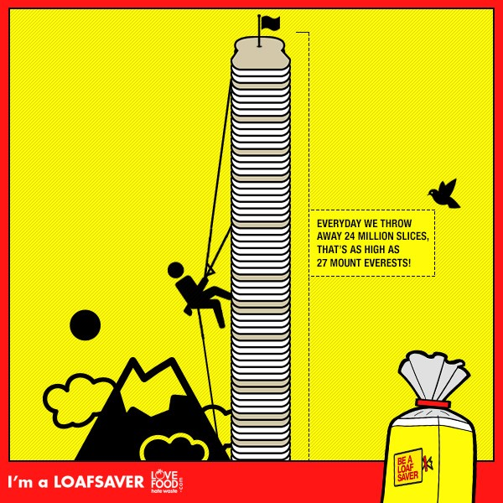
Every day we throw away 24 million slices of bread in the UK
Stacked up that’s as high as 27 Mount Everest’s!
Did you know you can toast your sliced bread straight from the freezer? So don’t waste it freeze it!
Notes:
Bread stays freshest if it stored in a dark dry place - like a bread bin or cupboard. But if you think a whole loaf is too much to get through why not freeze half and use it as you need it?

Slide 16

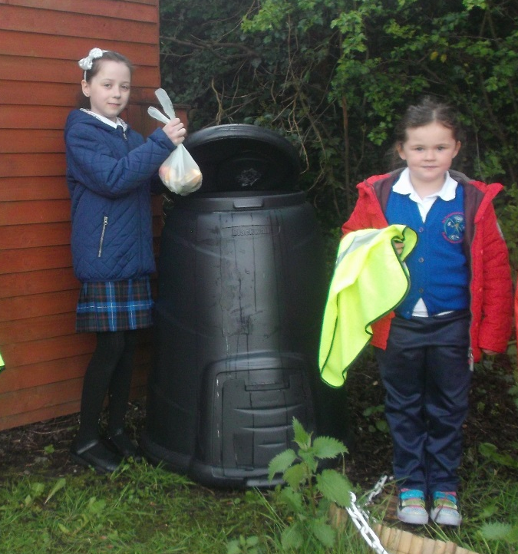
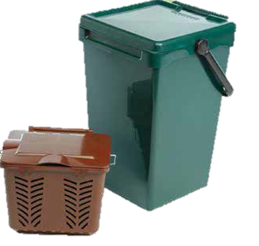
If you have food scraps that have to be thrown away then check if they can be recycled in the compost or brown bin.
Antrim and Newtownabbey Borough Council’s Waste team can visit your school to talk about composting contact Joanne.Templeton@antrimandnewtownabbey.gov.uk
Notes:
Can the pupils think of any other products they have commonly seen made from recycled materials?

Slide 17
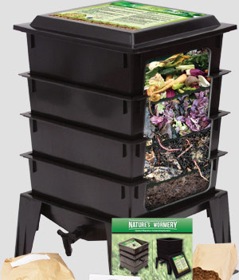

You could use a wormery to make compost.
Wormeries are great for composting small amounts of food waste
They make really good compost and plant food
You have to take care of your worms and look after them!
Notes:
Wormeries are a great way to compost small amounts of food. You add food scraps into the top tray and the worms will keep working their way up looking for new food. They leave behind a lovely layer of compost in the bottom tray which you can empty out and rotate to the top. There is a tap in the bottom to drain off liquid which makes fabulous plant feed. Contact Eco-Schools for more information.

Slide 18
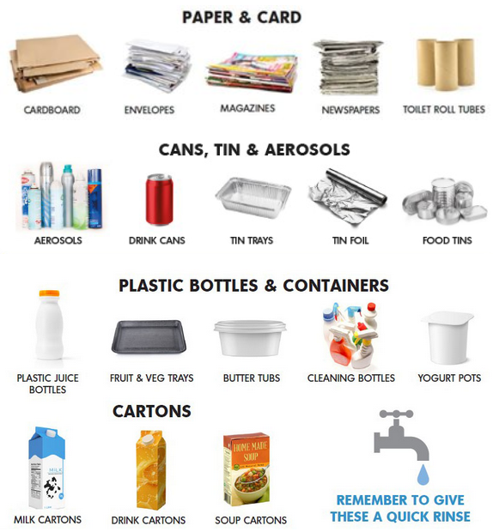

Each school is a bit different with what they can recycle but in general the following items can be recycled (including at home!)
Notes:
This information is from the Antrim and Newtownabbey Borough Council website where there is lots of helpful advice on recycling at home.

Slide 19


Black bin landfill waste costs nearly twice as much than recycling food to compost
Black Bin Waste goes to Landfill
Each bin lorry costs £1000 pounds to dispose of.
Food Bin Waste goes to compost
Each bin lorry costs £520 pounds to compost.
Notes:
Landfill taxes are increasing all the time which means that disposing of waste this way is expensive. Landfill taxes will cause the cost of a lorry of waste to landfill to increase to £1000 in April 2015. Recycling is a much better option for the environment and our purse strings as it provides a valuable resource for manufacturers and is cheaper than producing new products from raw materials.

Slide 20


Activity
What food will you not waste?
Make a poster to show off what food you
won’t throw away this week
It might be something that you
or something that you don’t normally eat but will try now

Slide 21
Don’t Dump…Decrease!
At the end of the day, ask students to dump the remainder of their lunch into the appropriate bins (food and packaging).
Fill out a chart of what was thrown away and why.
Add waste to the bins for one week and weigh each bin at the end of the week.
Repeat steps 1-3 for a second week and note any difference in weight.
How can you reduce your food waste?
Notes:
Weigh the waste packaging and food for a week and use this to discuss what kind of things the pupils are throwing away. Try to get suggestions on how they could reduce this and maybe send a note home to parents asking them to consider some options. Carry out the same steps for a second week and see if there’s a difference – hopefully there will be less!

Slide 22

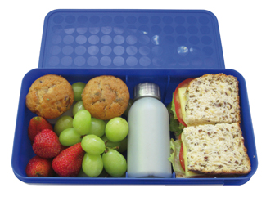
Home Actions
Go online to Love Food Hate Waste to help you with food planning at home: https://www.lovefoodhatewaste.com/
2. Plan a waste free lunch box – no wrappers that can’t be recycled and no wasted food!
Notes:
It is important that pupils recycle not only in school but at home as well. Here are ideas that you could set as a homework task for pupils and they can follow up and discuss the results in class. Include home actions taken in your reporting for the Wheelie Big Competition – we love to hear your ideas and the results.

Slide 23
School Actions
Help your Eco-Committee research waste at school.
How many food recycling bins does the school have?
Are they being used in the best way?
Are food items in your waste bin that should be in the recycling bin?
What could you do to improve things?
Keep a record of your actions – have they worked?
Notes:
Use the Worksheets Audit 1 and Audit 2 to investigate and report on actions in school.

Slide 24

Submit your findings, actions and results on waste to Eco-Schools by Thurs 16th May to be entered into the Wheelie Big Competition.
Schools are invited to present their waste projects in an interesting display at Mossley Mill on Thurs 30th May for final judging.
Win your school a great prize and help work towards your next Eco-School award.
Notes:
Use the Worksheets Audit 1 and Audit 2 along with a short explanation of actions and results at the school and home as your Wheelie Big Competition Entry. Return them by Thurs 2nd May to be shortlisted. Shortlisted schools will be invited to Belfast City Hall to present a display on their Wheelie Big Waste actions to judges in June. This is a great chance to see what other schools are doing and win a prize for your Eco-Schools work – up to £500.

Slide 25
Useful Contact Information:
Antrim and Newtownabbey Borough Council, Waste Education and Awareness Officer: 028 9034 0254 Joanne.Templeton@antrimandnewtownabbey.gov.uk for visits and composting advice.
Eco-Schools :028 9073 6920
eco-schools@keepnorthernirelandbeautiful.org

